Slide 1
2020
NODPA Field Days Virtual Presentation
Extending and Administering Homeopathic Remedies
By Maureen Knapp
cvfarm@icloud.com
607-591-9607

Slide 2
Homeopathic remedies can be easily transformed from traditional sugar pills to liquid form. This allows for the purchasing of smaller vials of pills, thereby spending less money; and also for easier administration of the remedy to both animals and people.
There is also evidence that the administration of remedies in liquid form is gentler to the body, easing any healing reactions and and potential return of symptoms as the body works with the remedy.

Slide 3
One ounce dropper bottles and two ounce spray bottles are the most common sizes and methods for single administration. Spray bottles are the easiest to use for cows.
Larger bottles – 4 oz and up can be used for easy water trough administration to large herds. The 2oz. Spray bottles can also be used in the the water trough.

Slide 4
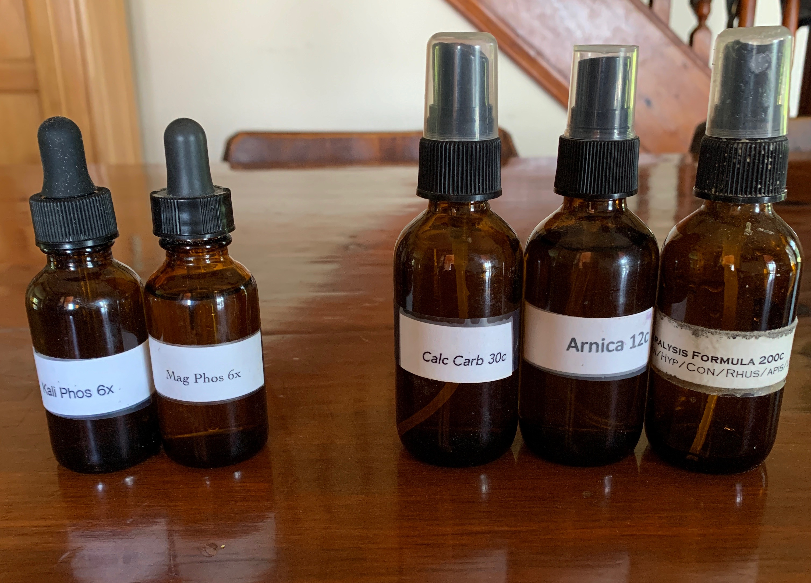
1 oz Dropper Bottle
2 oz Spray bottle

Slide 5
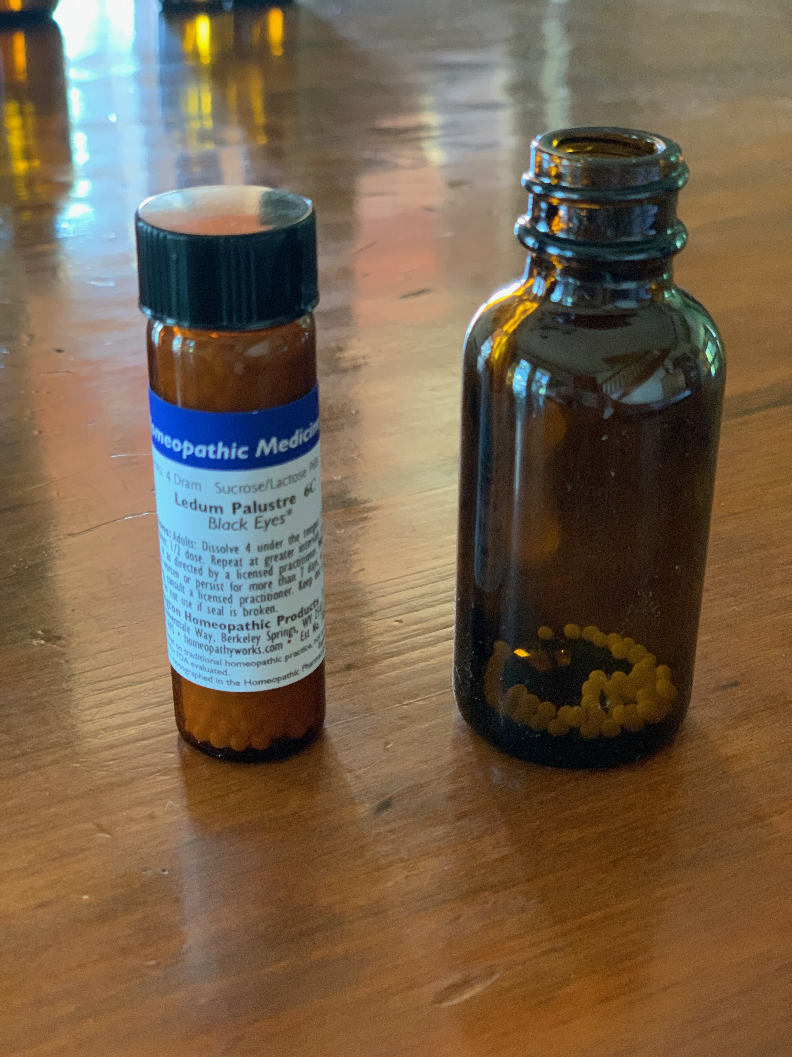
To extend the remedy, tap some pills into the bottle….

Slide 6
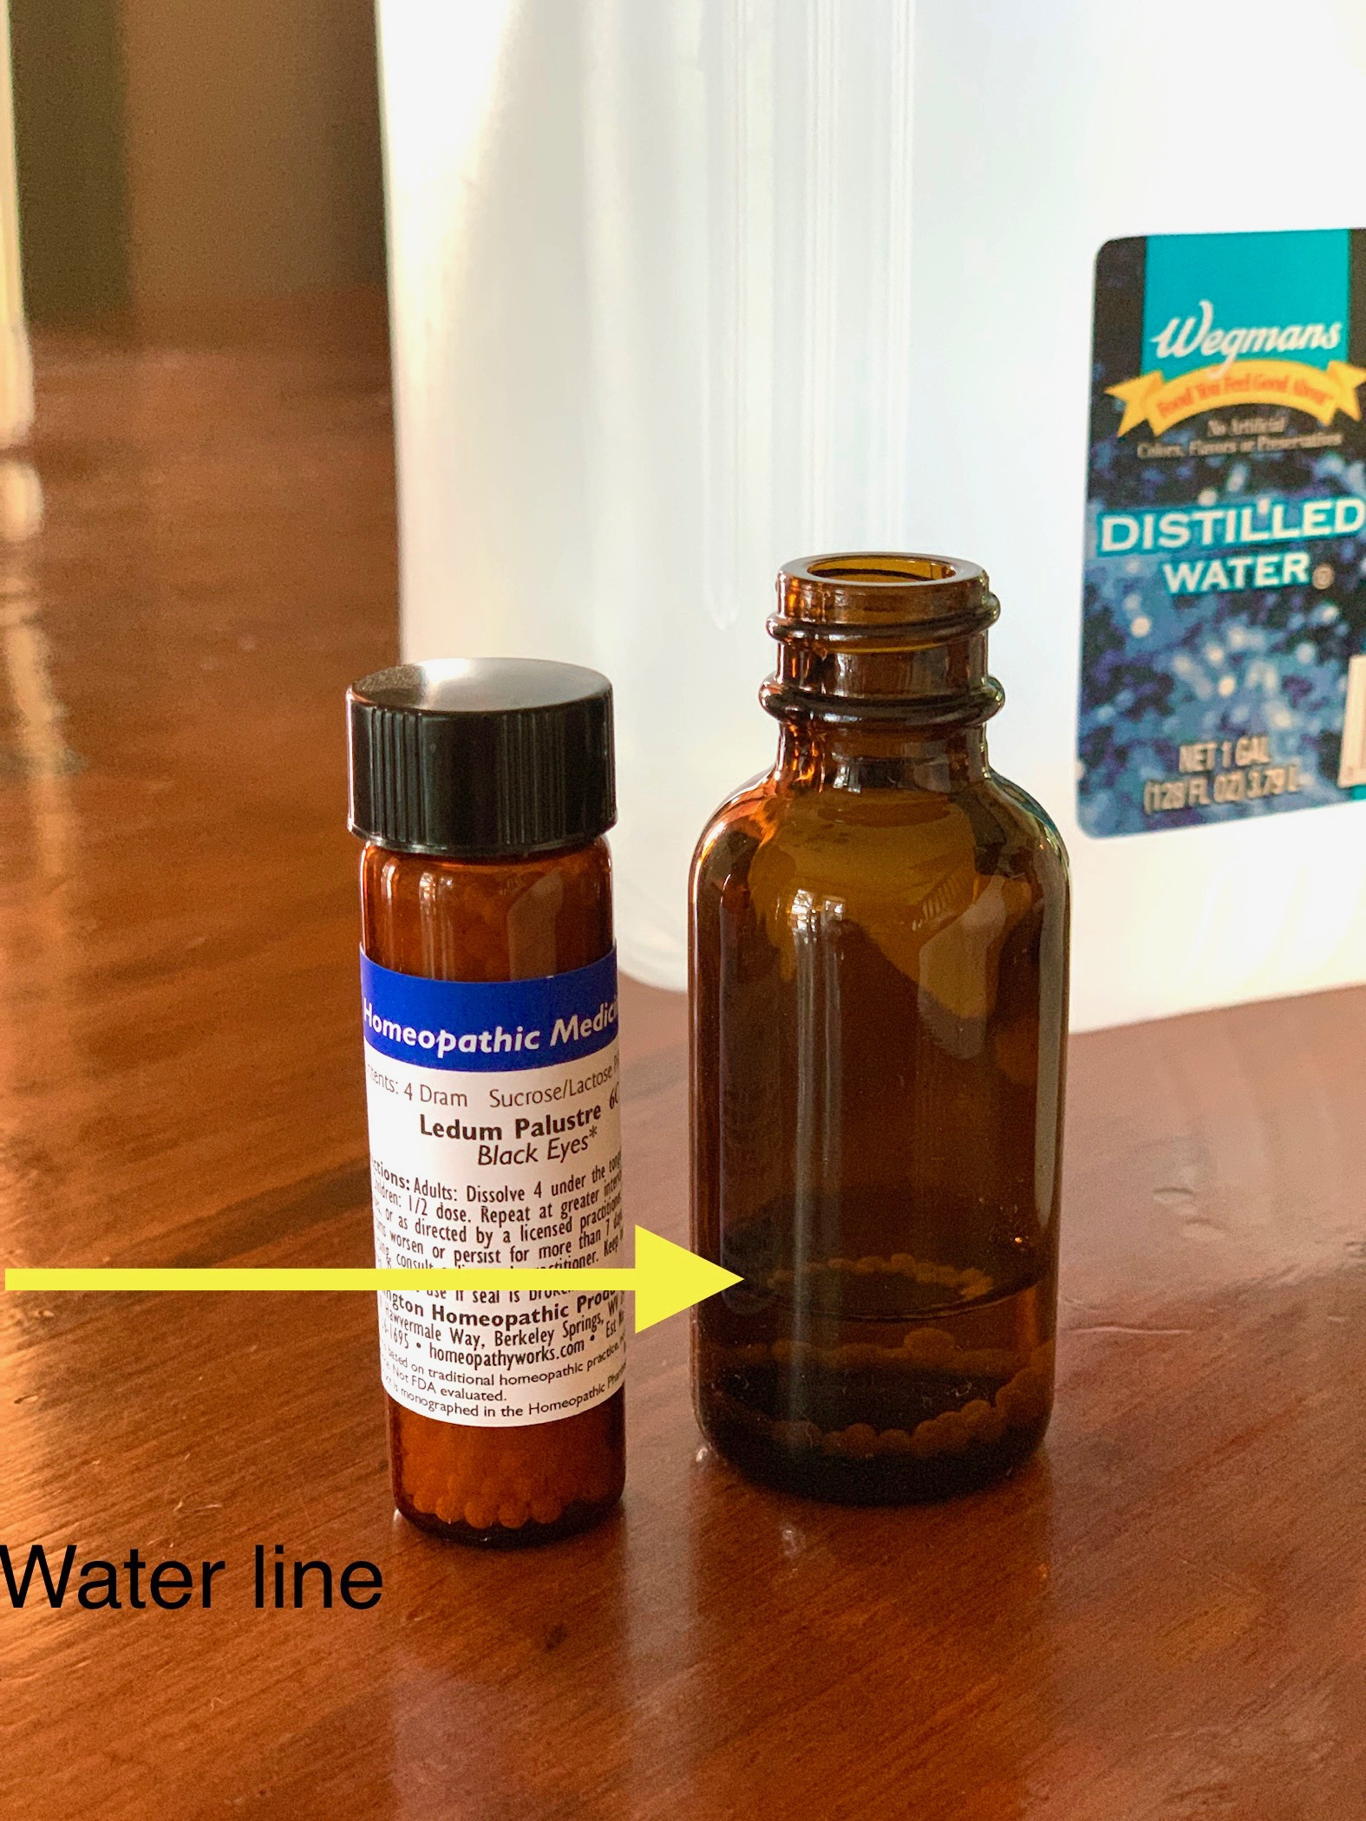
…pour some distilled water into the bottle to cover the pills, and then just a bit more. Ideally the pills will dissolve before adding alcohol, but it is not necessary if you are in a hurry.

Slide 7
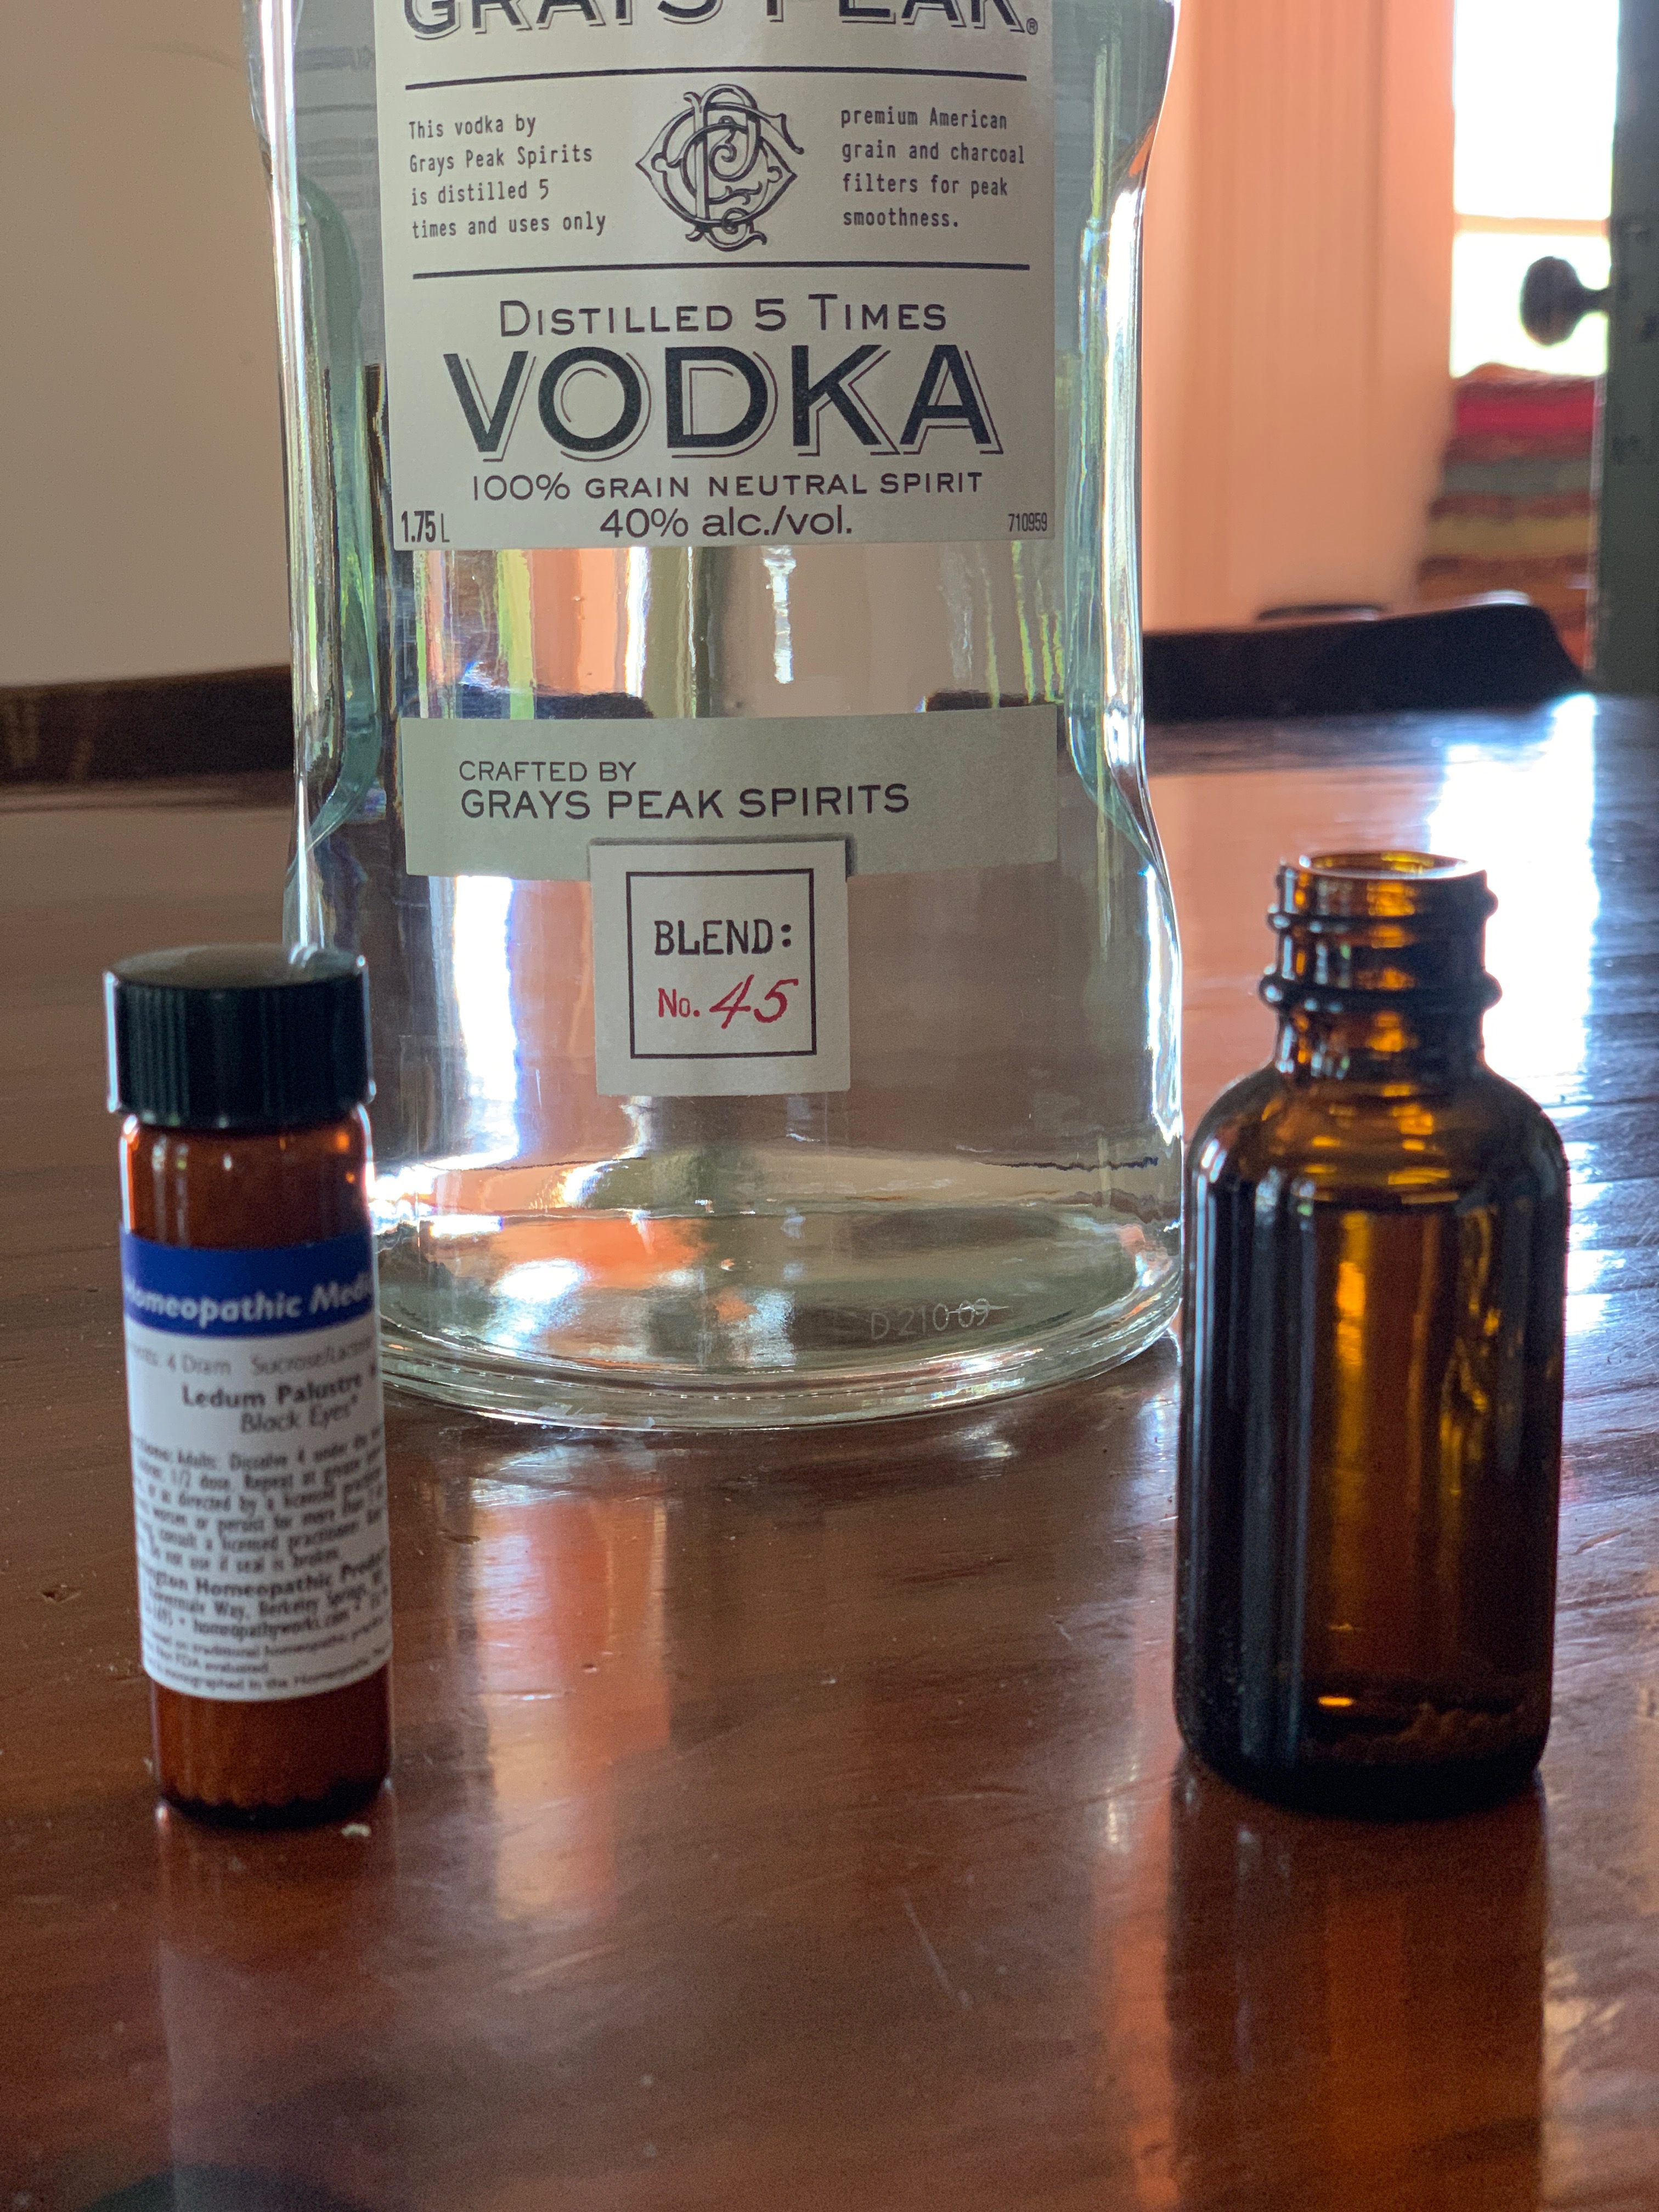
Top the bottle off with a good quality alcohol.

Slide 8
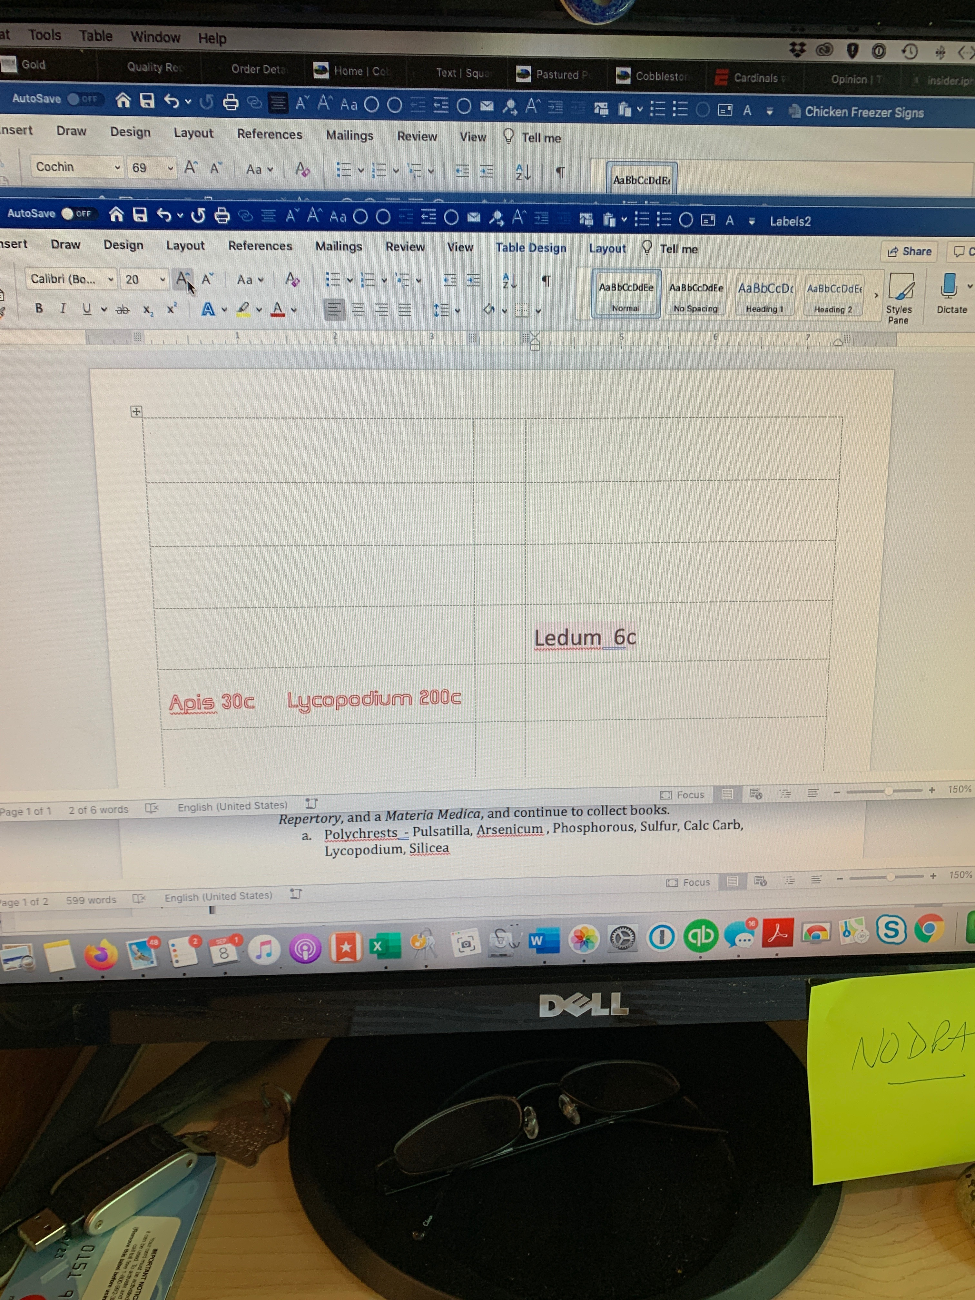
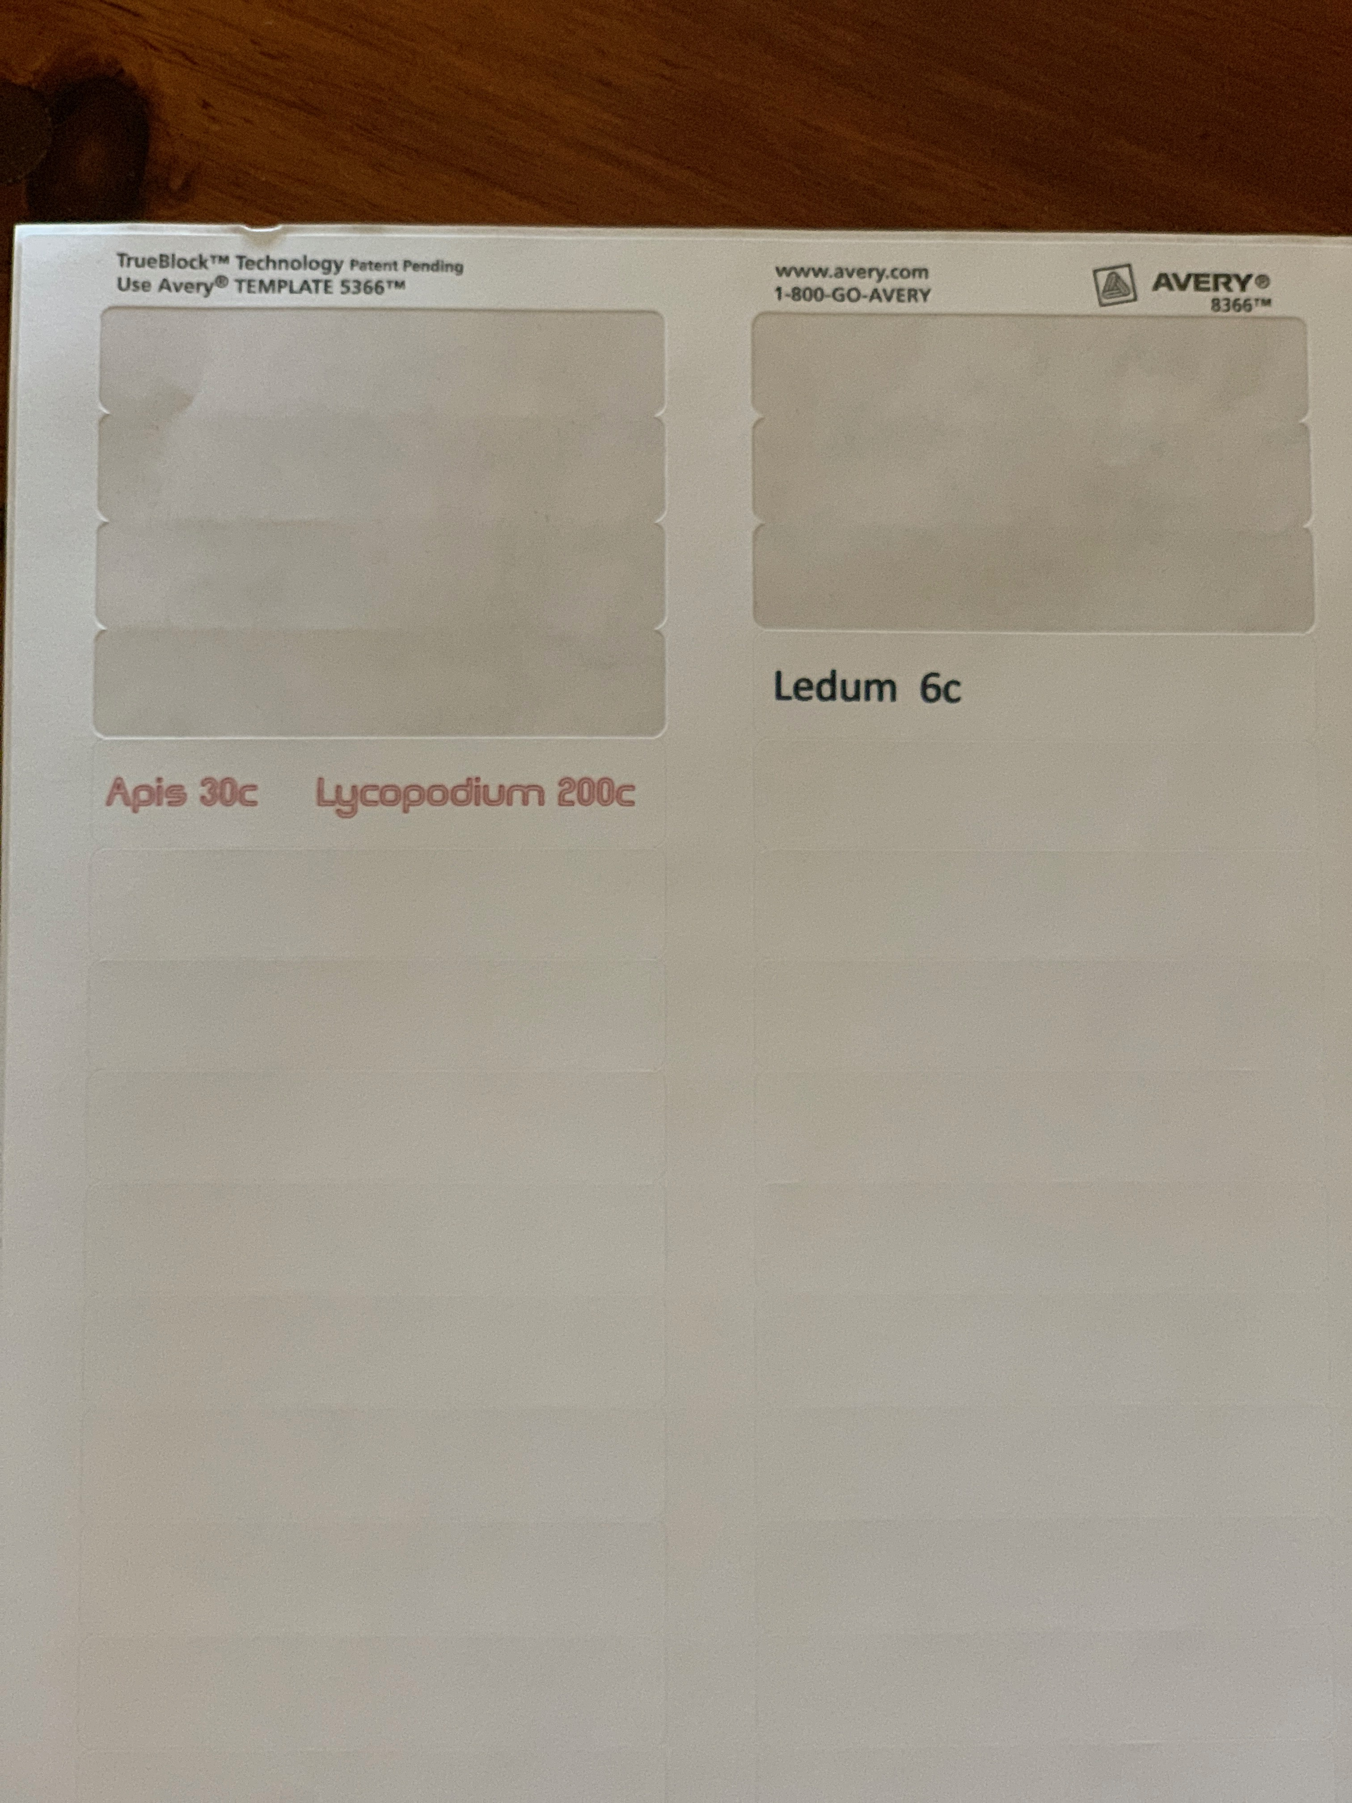
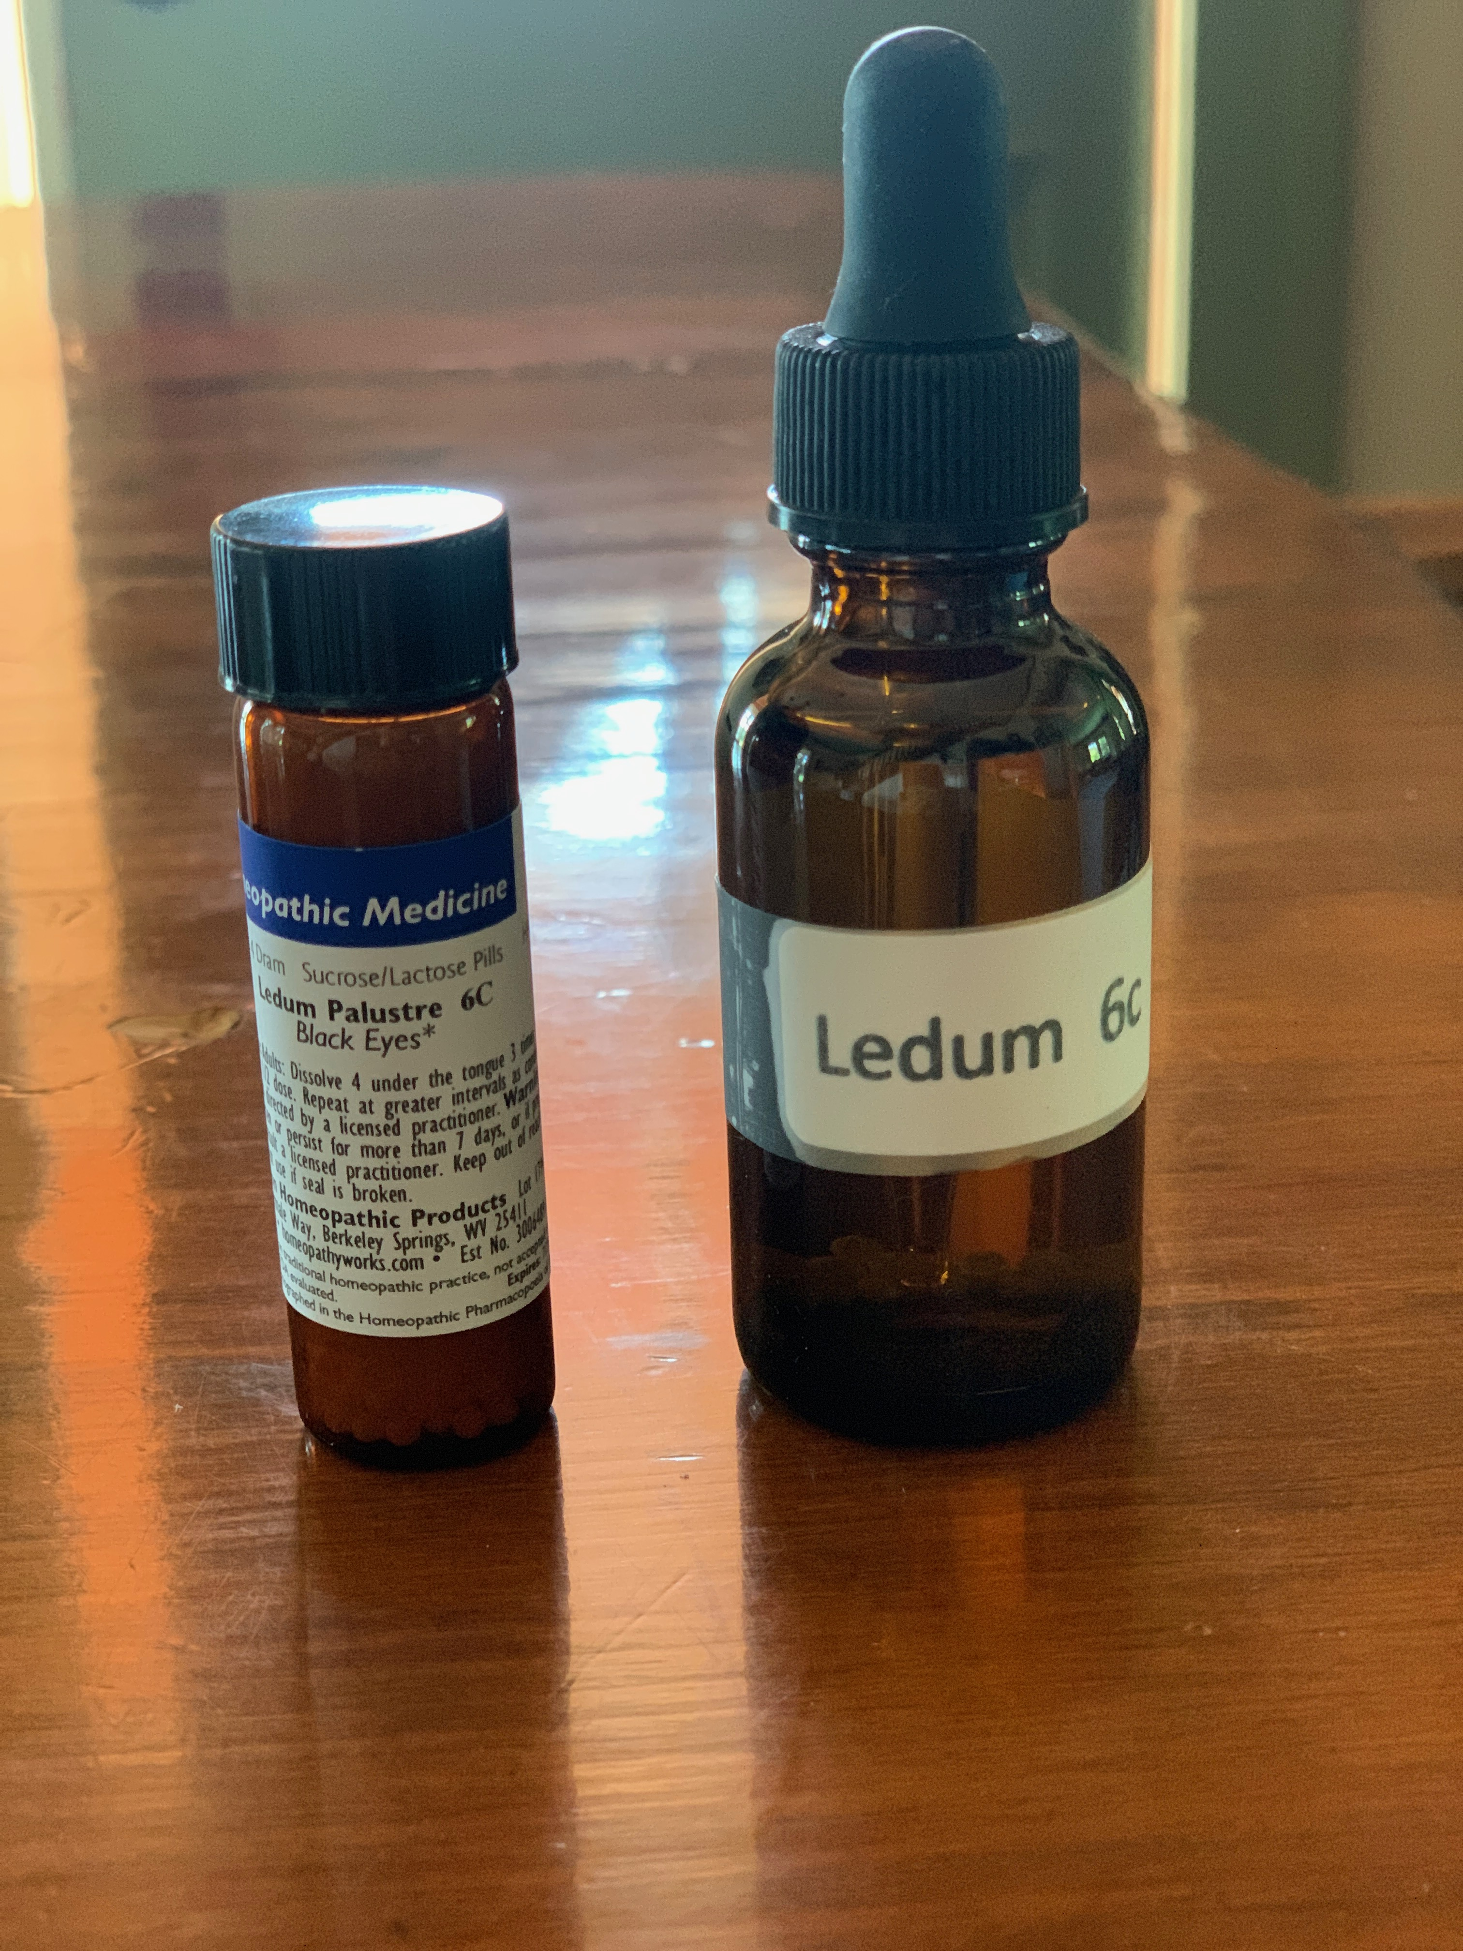
Once the remedy is made, label immediately with the contents. You might think you’ll remember what is in the bottle – but you won’t! Once you’ve applied the label to the bottle, cover (protect) the label with scotch tape.

Slide 9
3 Short videos on spray remedy administration: Vaginal, nose, and water.

